Slide 2
Best Practices for Cross-Platform .NET 8 Applications
Speaker name

Slide 3
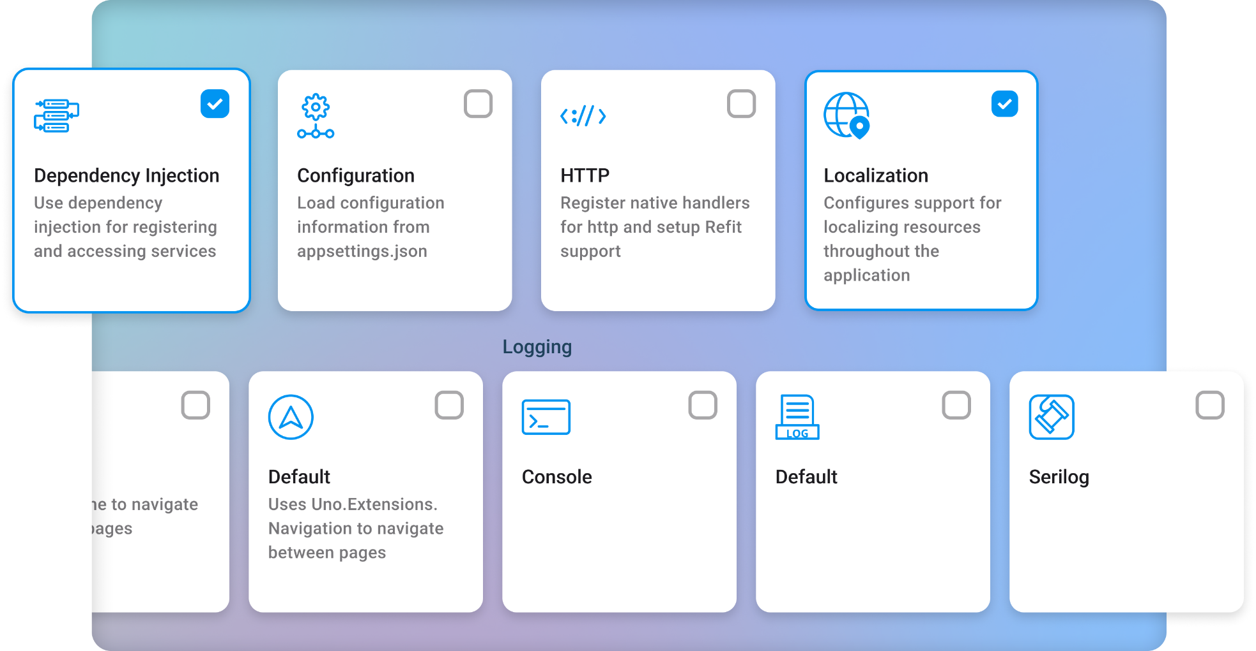

Slide 4
Navigation
Easily move between pages, open dialogs etc via the use of Frame, TabBar, NavigationView or ContentControl.

Slide 5
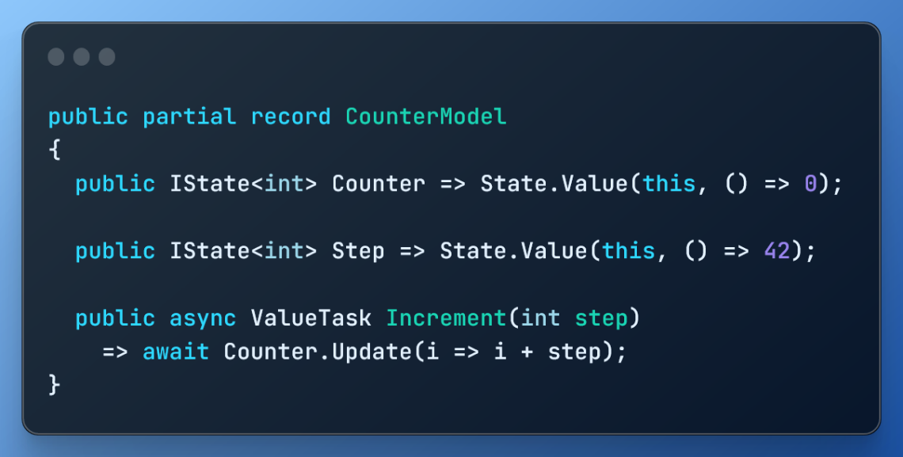
MVUX
Reactive programming for mere mortals. Easily create asynchronous and event-based cross-platform .NET apps

Slide 6
Authentication
Easily authenticate a user or restrict access to specific parts of the application using MSAL, OIDC, Cookie or simple Web authentication.

Slide 7
Demo
Tube Player App

Slide 8
Resources
Get Started https://platform.uno/get-started
Simple Calculator Workshop https://platform.uno/simple-calc/
Tube Player Workshop https://platform.uno/tube-player/
Get Help https://platform.uno/support/

Slide 9
Download .NET 8
https://aka.ms/get-dotnet-8

